Slide 1
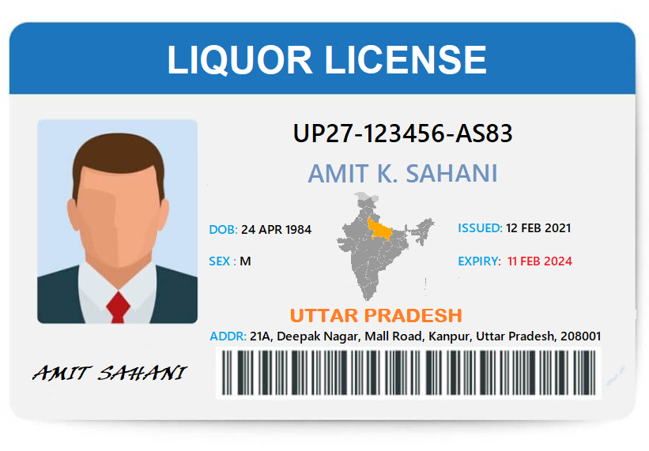
PERSONAL LIQUOR CONSUMPTION LICENSE

Slide 2
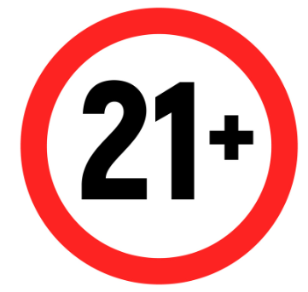
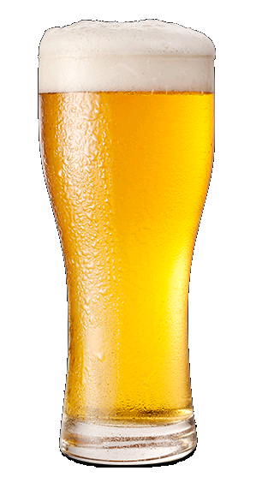
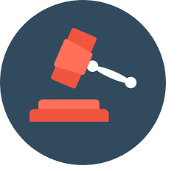
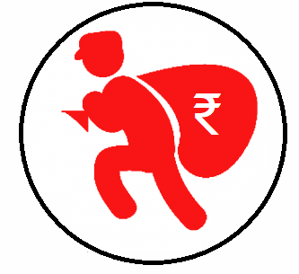
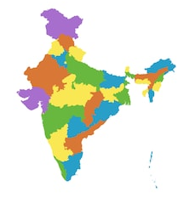
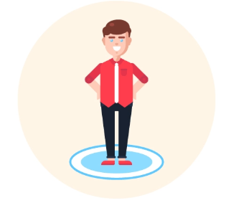
Problem Areas
Under-age drinking is prevalent in entire country & is proven to be related to health problems, teen suicides & alcohol addiction.
Under-age drinking is also related to social issues like episodic drinking, stepping stones to drugs & mental instability.
Liquor consumption laws are present but there are no recorded enforcement
Scammers trick foreigners & unaware consumers to pay unlawful penalties
The laws differ by state & type of liquor, which makes it very hard to apply & even follow
No means to understand or track self-consumption behavior, to take corrective actions

Slide 3
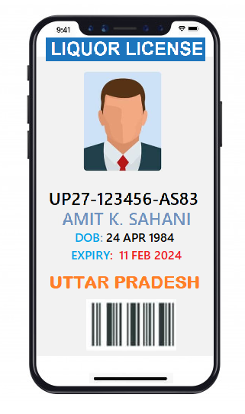
Solution via Mobile App
Nationalized License
Provision issuance of F.L.X-C license acceptable across nation
Ease of Convenience
One-Stop app to request all applicable licenses & permits
Age Verification
Ensure alcohol is sold to consumers who are above legal drinking age
Eliminate Scams
Avoid falling prey to scammers who extort unassuming consumers
Regulatory Compliance
Alignment & enforce alcohol consumption rules, as directed by law
Revenue From Tourists
Additional revenue by issuing online license to tourists & foreigners
Accurate Guidance
Consumers & sellers to receive up to date & accurate instructions to operate
Cross State Validation
Smart features to reflect license validity by geography, as regulations vary by state

Slide 4
Key Statistics – Maharashtra
3rd Highest number of liquor consumer in India – Appx 3 CR
5.5CR is the average annual revenue generated per year by issuing temporary permits
in Maharashtra
10000+ liquor stores are operational in. This count does not include restaurants.
In May 2020, Maharashtra excise department approved home delivery of liquor
in Maharashtra
Top Consuming Cities:
Mumbai, Pune, Thane, Nashik, Nagpur, Aurangabad, Navi Mumbai, Solapur, Kolhapur
Maharashtra
Maharashtra is the most industrialized state & collects 8% of its tax from liquor
78Cr Daily sale average; to increase with COVID related recent changes
Before 2020 lockdown, liquor consumption in Maharashtra was growing with steady rate of 10%
1CR of IMFL & 2.1Cr of beer bottles are sold every month in Maharashtra.

Slide 5
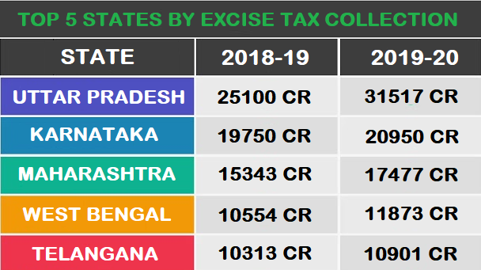
Key Statistics – India
Over 65% of liquor sale is based on IMFL & beer; remaining being country liquor.
Unrecorded alcohol makes up 51% of alcohol consumption in India.
88% youth start drinking before legal age & procure alcohol without age check.
66.7% underage consumers obtain alcohol from liquor shops, pubs, bar & restaurant.
90.1 consumers believe a form of regulatory check will curb underage drinking.
Average Urban consumers 4.3 liter per year while 11.4L in rural areas, per year.
33.1% of alcohol related underage deaths were due to traffic crash, self-harm & interpersonal violence.
India’s alcohol intake shows an increasing trend i.e. over 38% in last 7 years, owing to more disposable income amount youths.
Guidance on alcohol consumption is virtually non-existent in education system, until graduate specialized study programs.

Slide 6
Business Process
Business approach
Truevibes will develop a mobile/web app, to issue FLX-C license to consumers online. Additionally plastic ID cards will also be issued, which can be utilized virtually as well.
E-KYC check will be performed while issuing the license
Local government support will be required to enforce the legal regulation for state-wide compliance
Additional awareness campaigns will be carried out for report or most affected locations
Application database will be owned by excise department to assist statistical analysis & reporting.
Periodic maintenance & control checks will be applied to ensure accuracy & support future demand & expansion to other regions.
Types of licenses to be issued
Permit for the purchase, possession, transport, use and consumption of Foreign Liquor and Country Liquor (F. L. X-C).
One Day Permit for the purchase, possession, transport, use and consumption of Foreign Liquor (FL-F).
Temporary One Day Function License (F.L.IV.A).
One Day Permit for the purchase, possession, transport, use and consumption of Country Liquor (CL-C).
One Day Permit for the purchase, possession, transport, use and consumption of Liquor based food items.

Slide 7
Process Flow

Slide 8
Project Financials

Slide 9
Revenue Model

Slide 10
Roadmap & Timelines

